Slide 1
Galanthophilia A good kind of love
Presentation to the
North American
Rock Garden Society

Slide 2
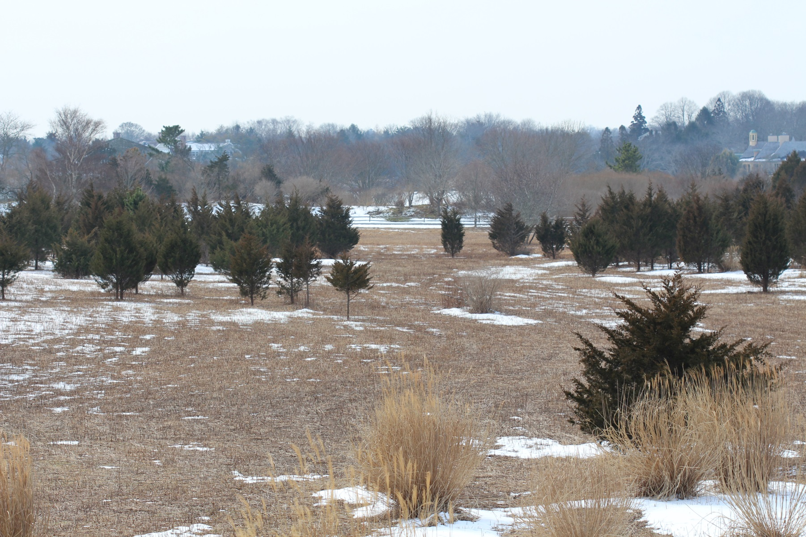
American Winter Scene
Galathophilia

Slide 3
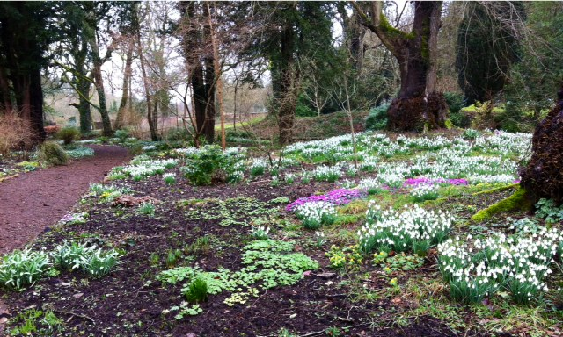
Galanthus At Colesbourne
Galathophilia

Slide 4
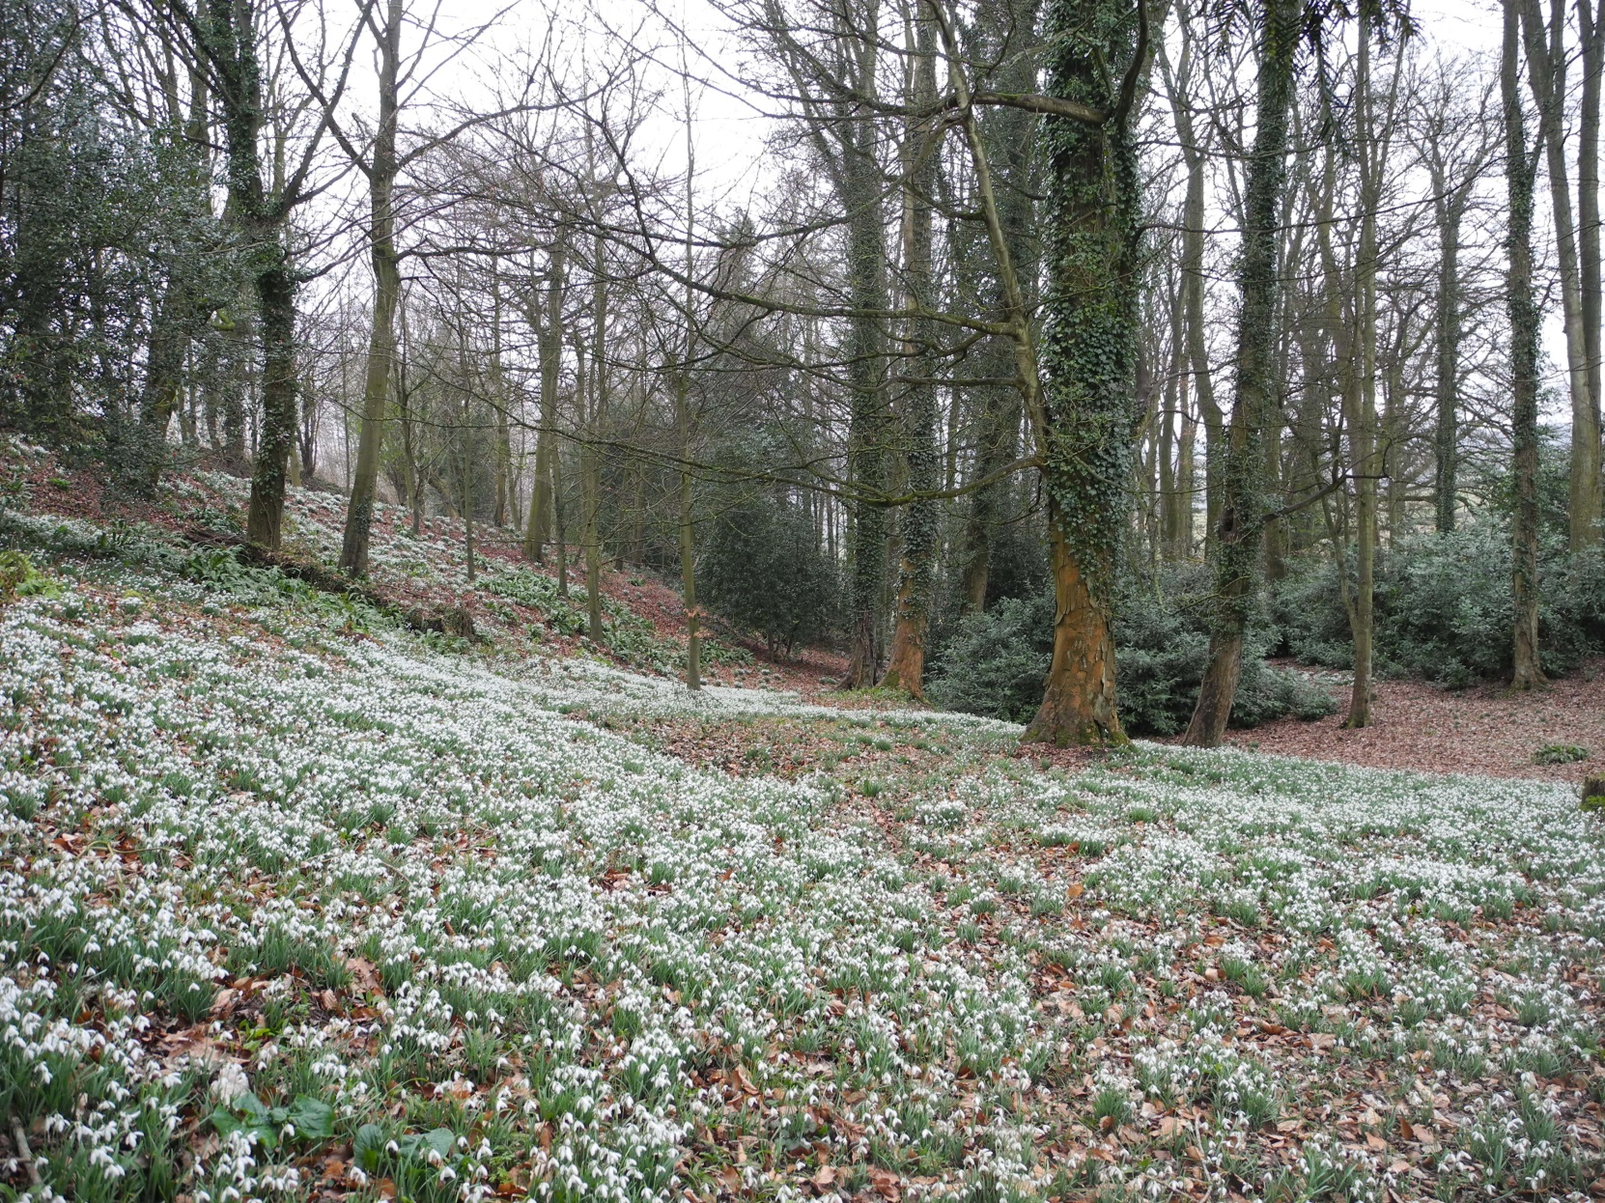
The Painswick Rococo Garden
Galathophilia

Slide 5
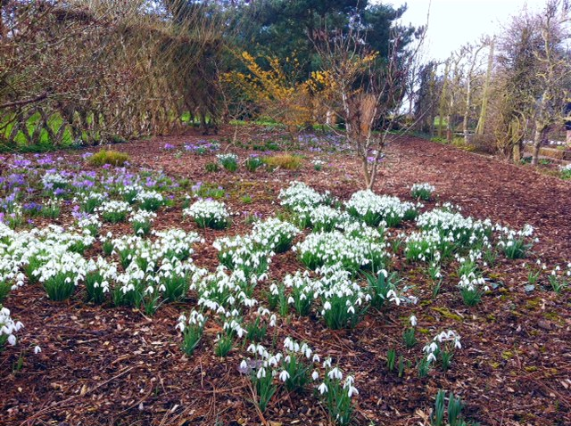
The Normans’ Garden
Galathophilia

Slide 6
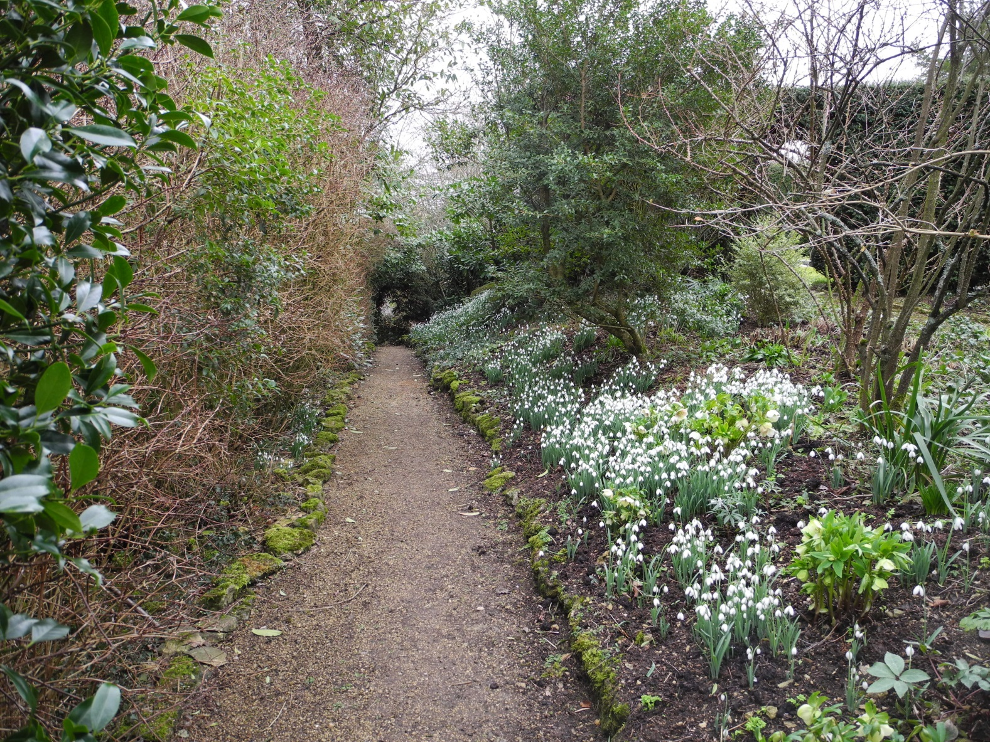
The Old Rectory
Galathophilia

Slide 7
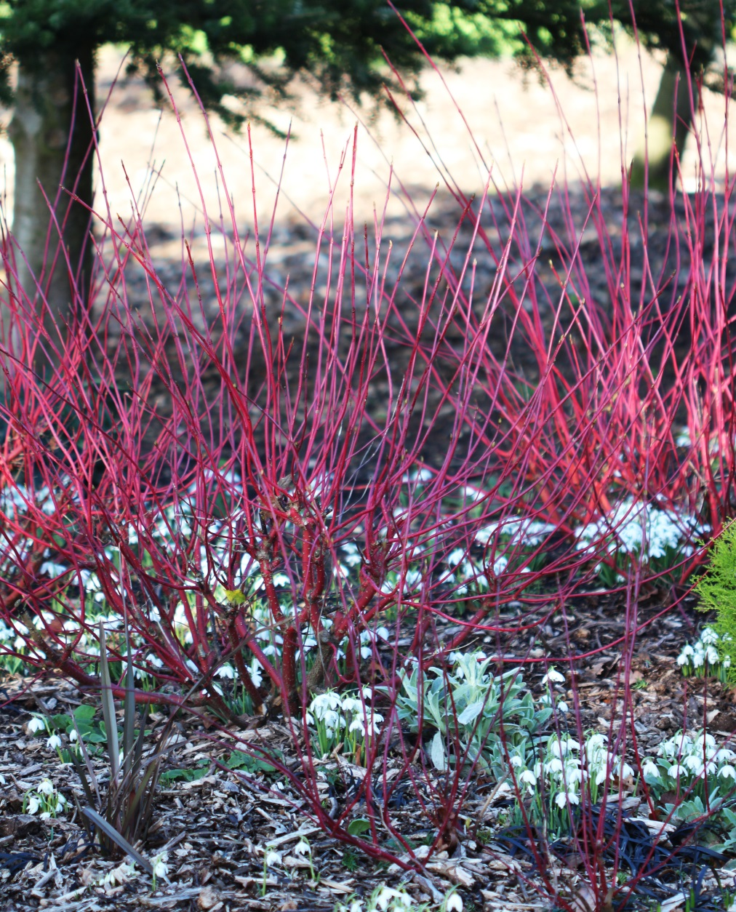
Ragley Hall
Galathophilia

Slide 8
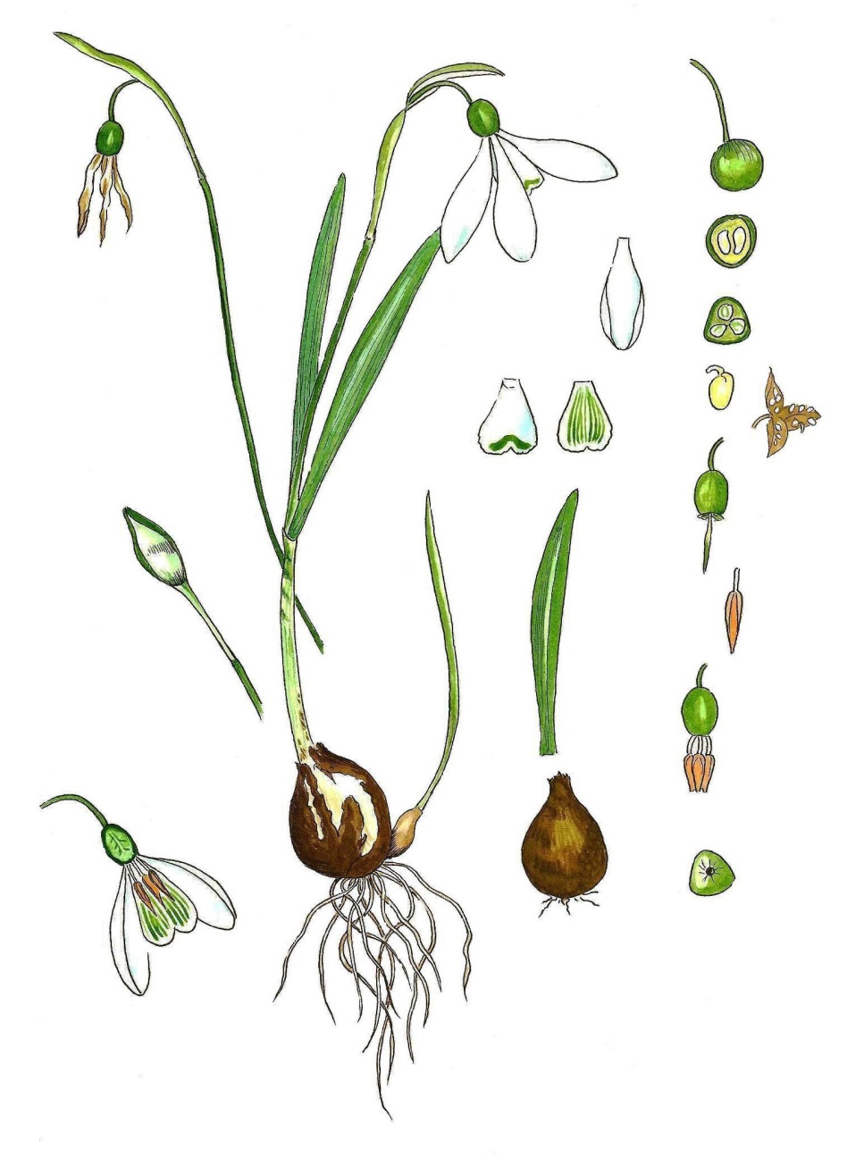
Galanthus Structure
Galanthophilia

Slide 9
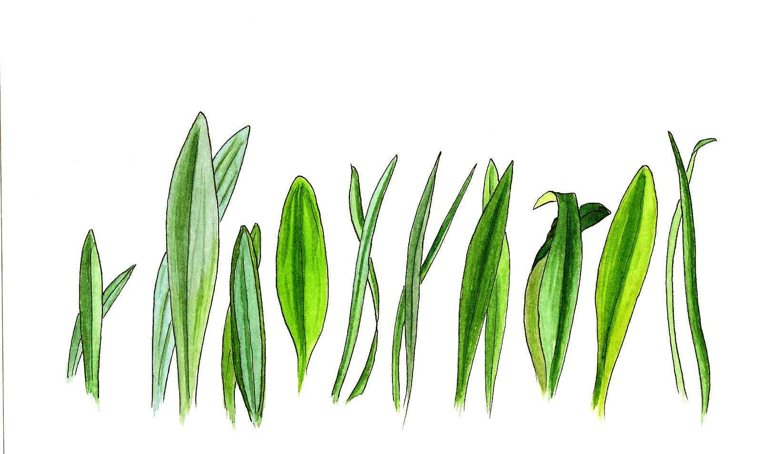
Galanthus Structure
Galanthophilia

Slide 10
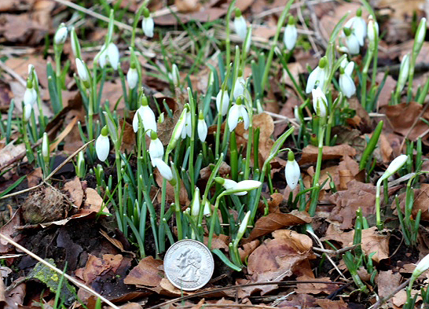
Species: Nivalis
Galathophilia

Slide 11
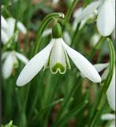
Species: Nivalis
Galathophilia

Slide 12
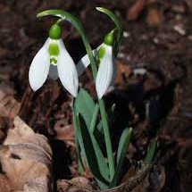
Species: Elwesii
Galathophilia

Slide 13
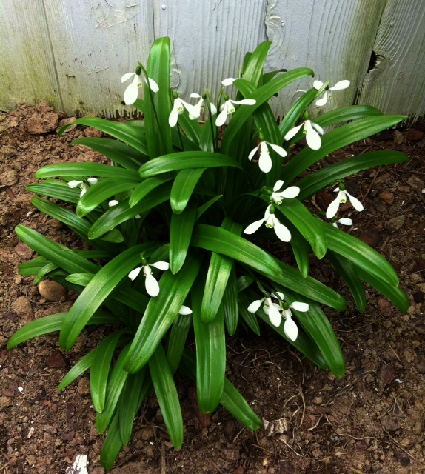
Species: Woronowii
Galathophilia

Slide 14
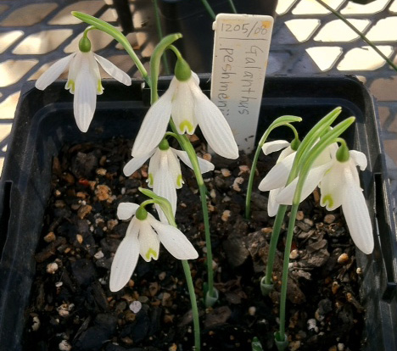
Species: Peshmenii
Galathophilia

Slide 15
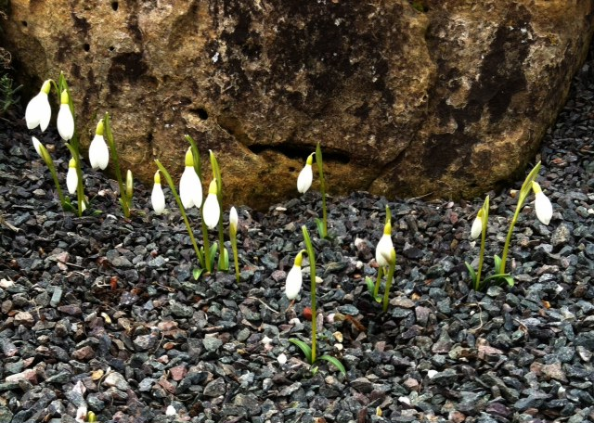
Species: Rizenhensis
Galathophilia

Slide 16
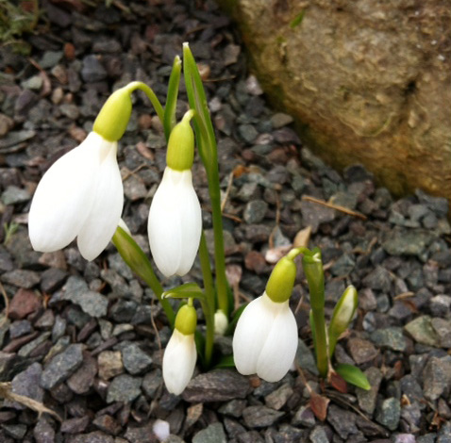
Species: Rizenhensis
Galathophilia

Slide 17
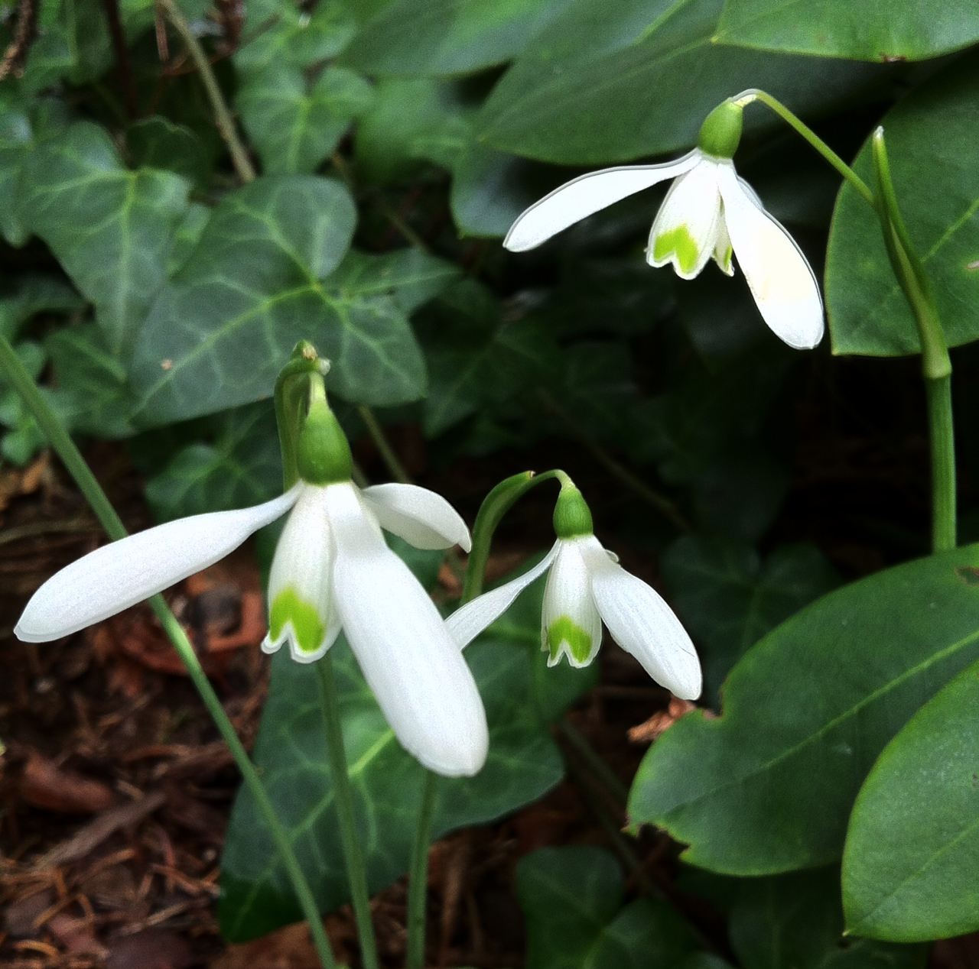
Species: Regina Olgae
Galathophilia

Slide 18
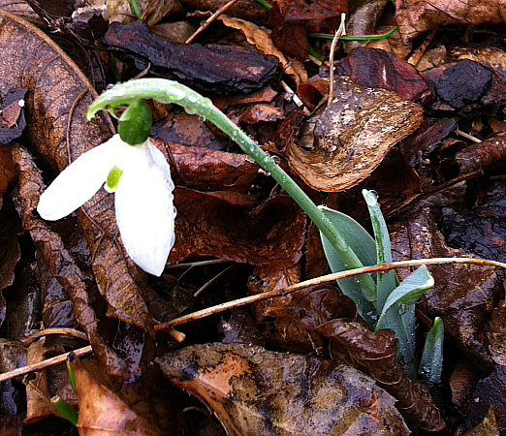
Early Snowdrops: Barnes
Galathophilia

Slide 19
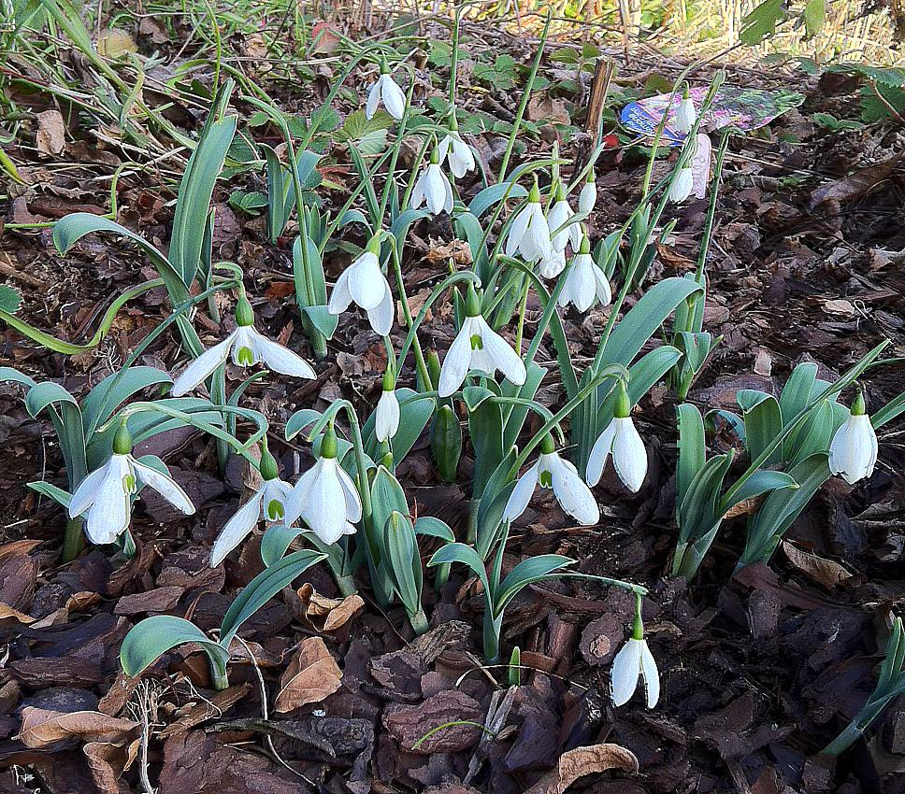
Early Snowdrops: Potter’s Prelude
Galathophilia

Slide 20
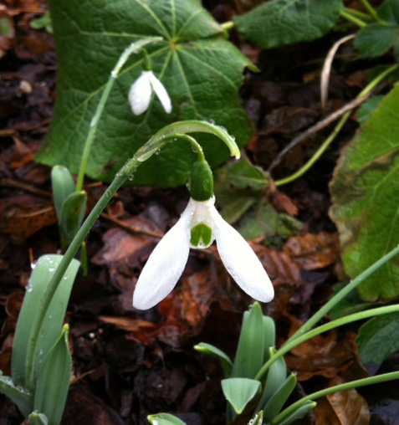
Early Snowdrops: Potter’s Prelude
Galathophilia

Slide 21
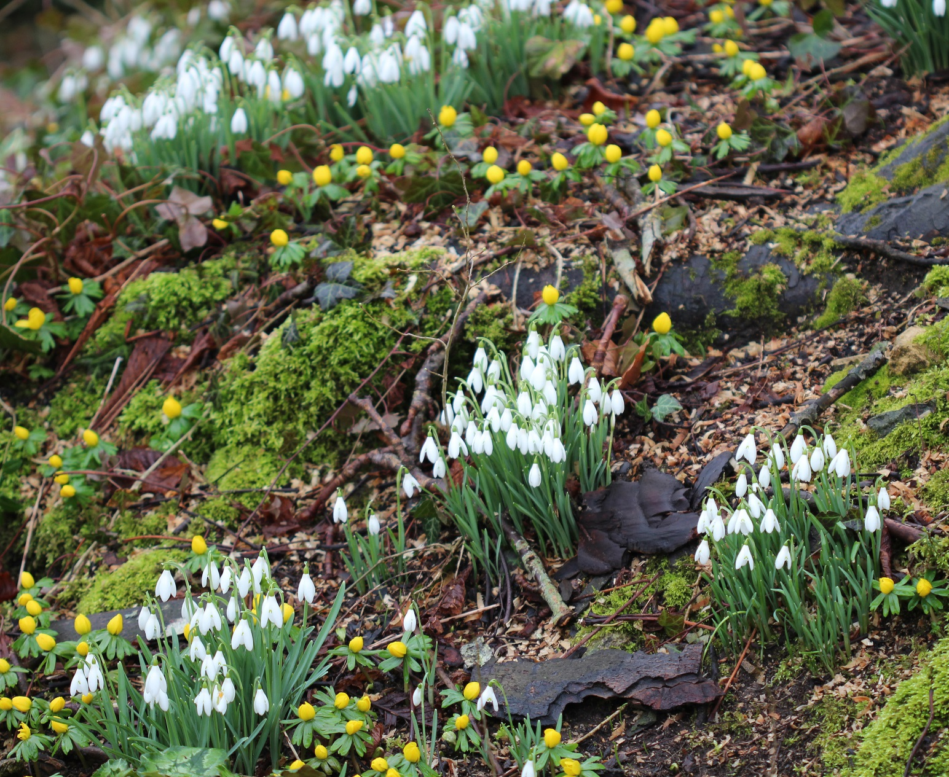
Good Doers: S Arnott
Galathophilia

Slide 22
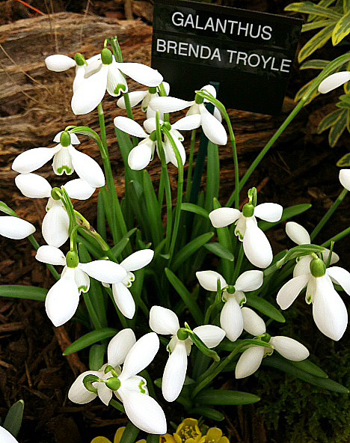
Good Doers: Brenda Troyle
Galathophilia

Slide 23
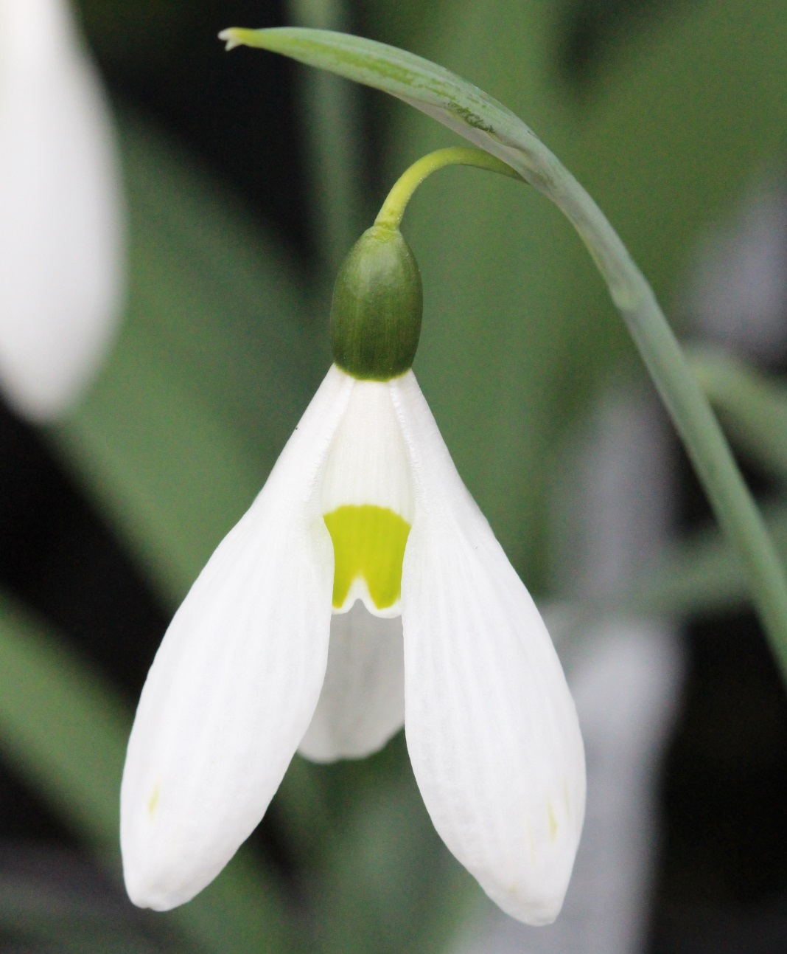
Good Doers: Comet
Galathophilia

Slide 24
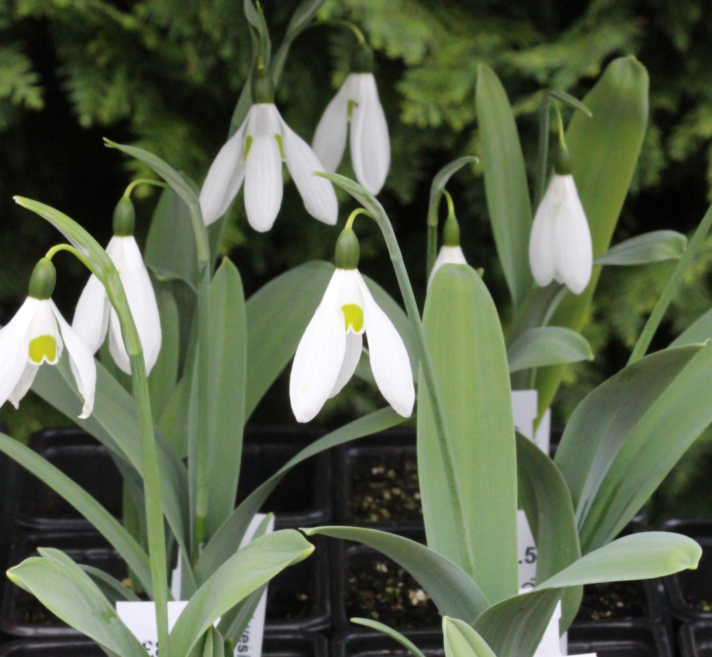
Good Doers: Comet
Galathophilia

Slide 25
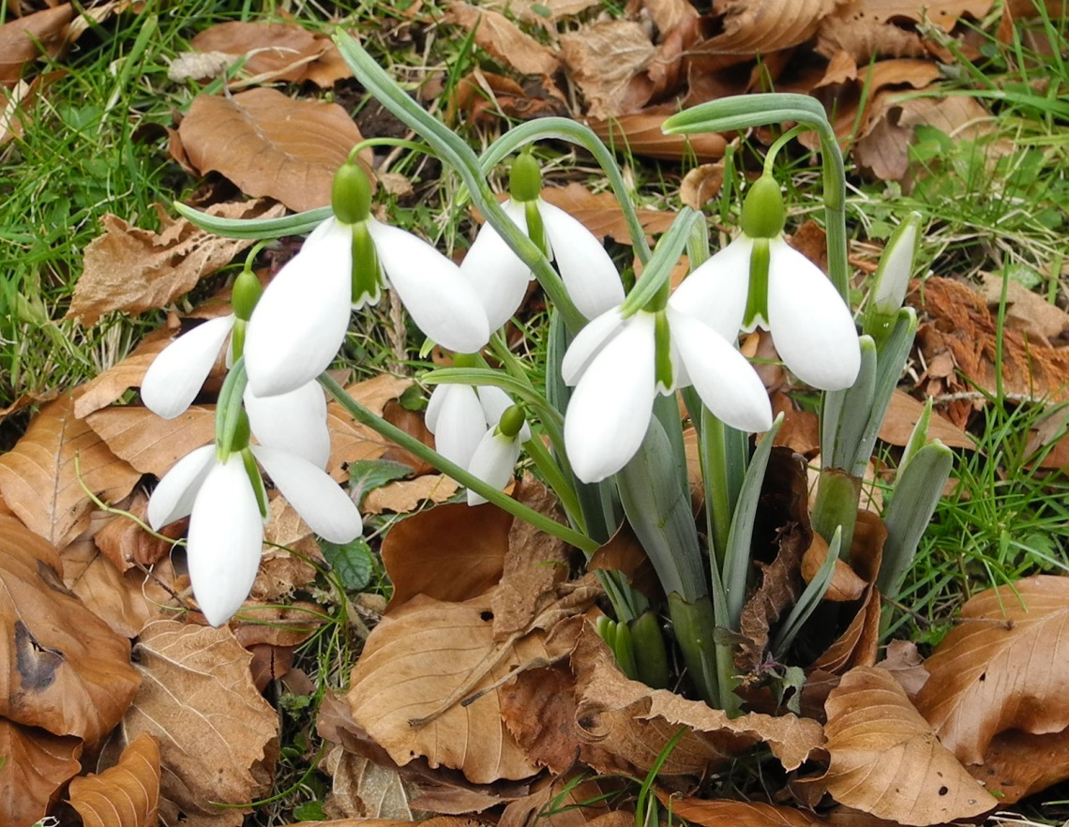
Good Doers: George Elwes
Galathophilia

Slide 26
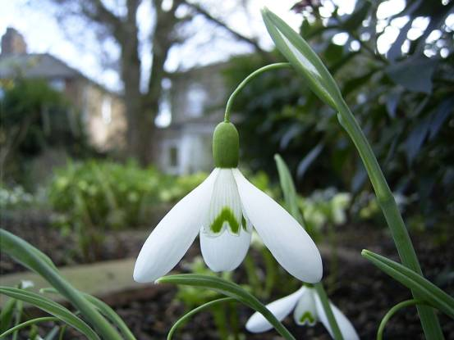
Good Doers: Magnet
Galathophilia

Slide 27
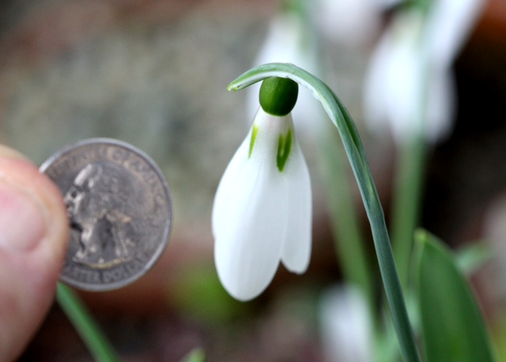
Good Doers: Ginns Imperiati
Galathophilia

Slide 28
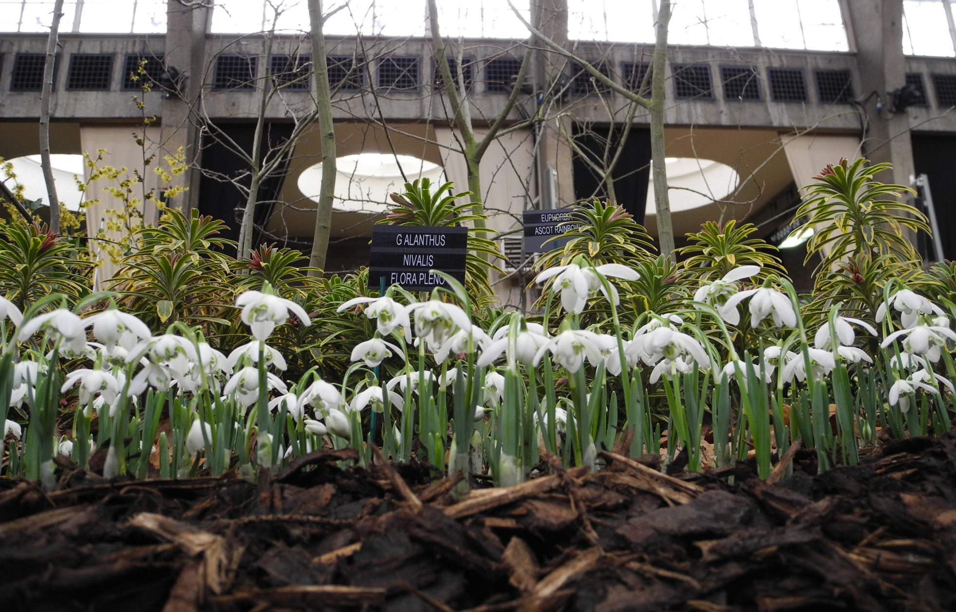
Doubles: Flore Pleno
Galathophilia

Slide 29
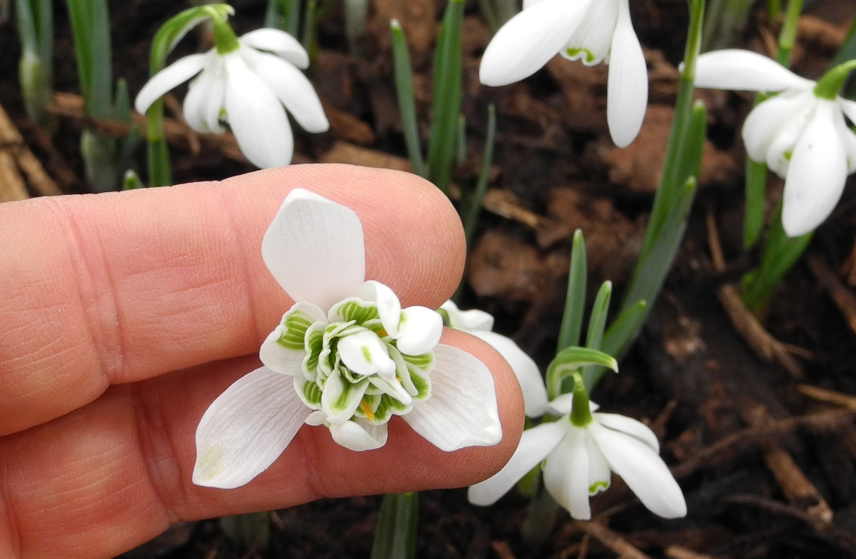
Doubles: Flore Pleno
Galathophilia

Slide 30
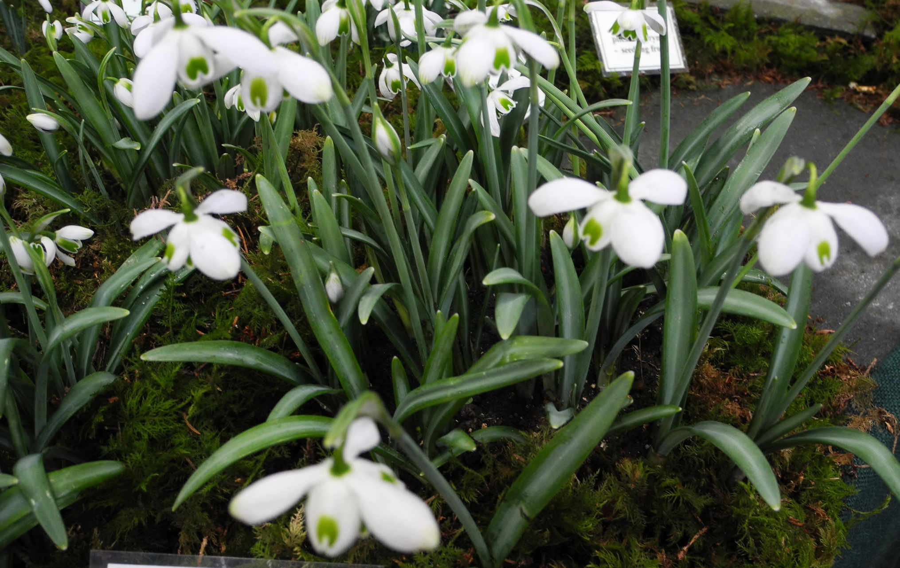
Doubles: Hippolyta
Galathophilia

Slide 31
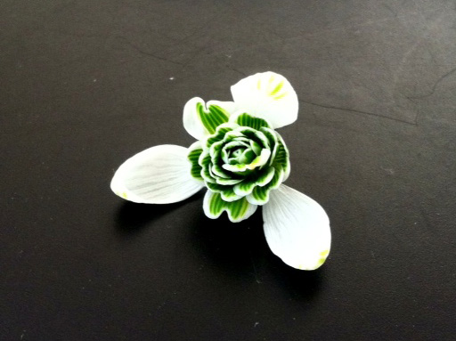
Doubles: Hippolyta
Galathophilia

Slide 32
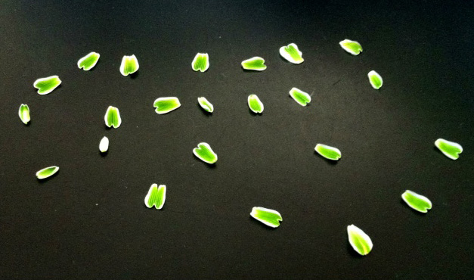
Doubles: Hippolyta Deconstructed
Galathophilia

Slide 33
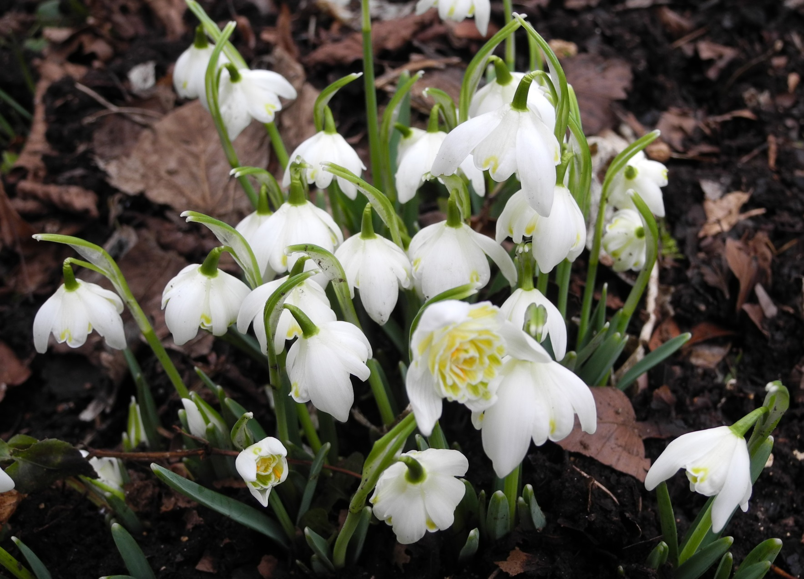
Doubles: Lady Elphinstone
Galathophilia

Slide 34
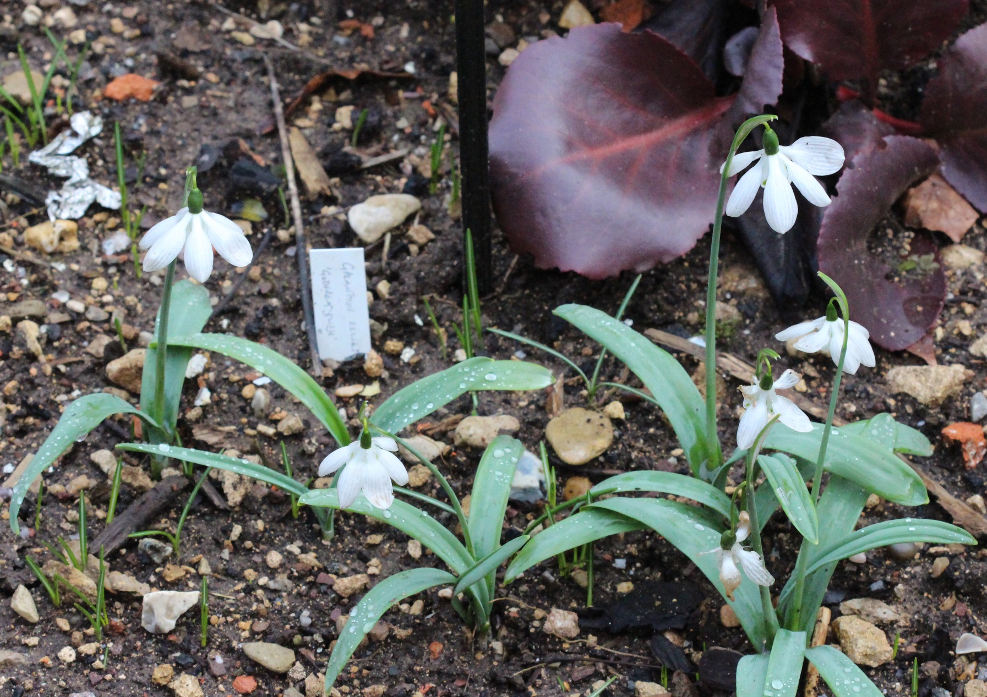
Doubles: Godfrey Owen
Galathophilia

Slide 35
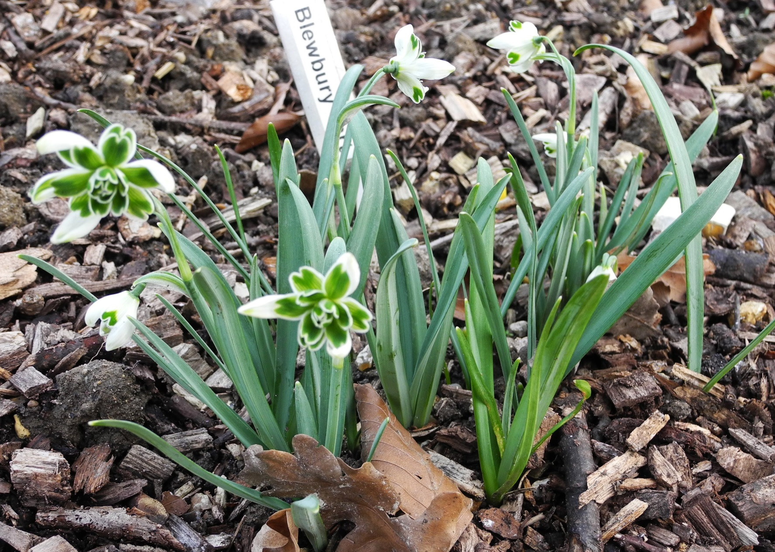
Doubles: Blewbury Tart
Galathophilia

Slide 36
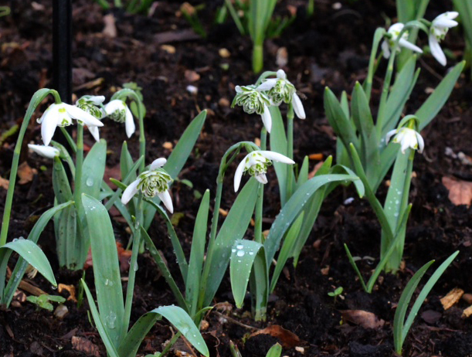
Doubles: Esther Merton
Galathophilia

Slide 37
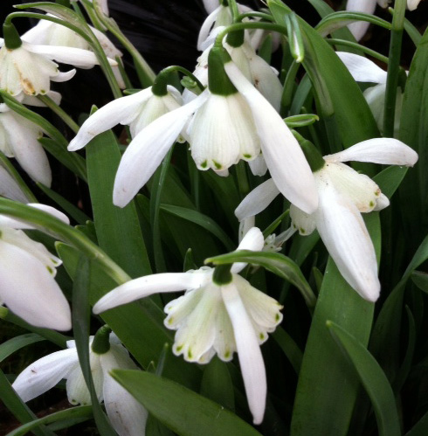
Doubles: Lady beatrix Stanley
Galathophilia

Slide 38
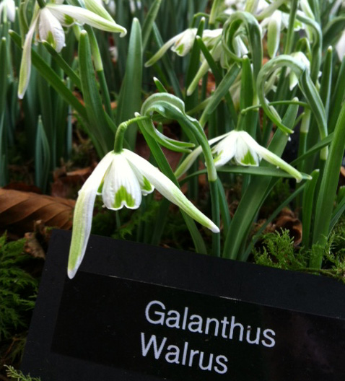
Doubles: Walrus
Galathophilia

Slide 39
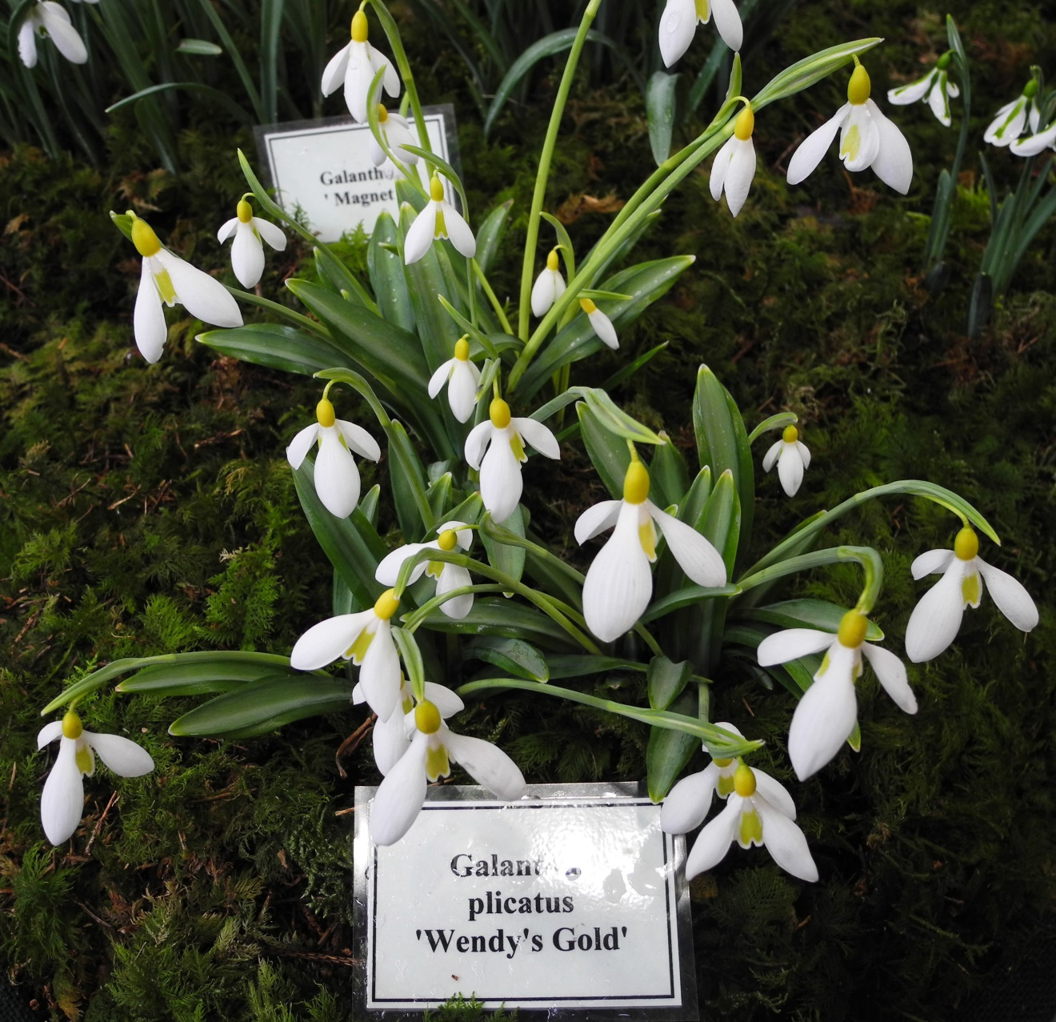
Yellows: Wendy’s Gold
Galathophilia

Slide 40
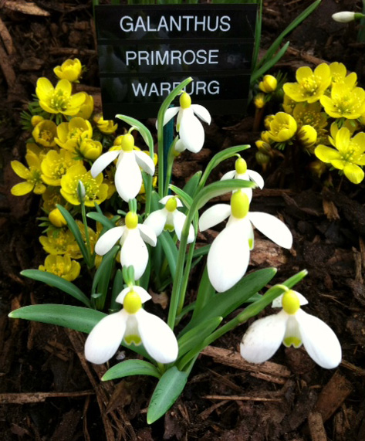
Yellows: Primrose Warburg
Galathophilia

Slide 41
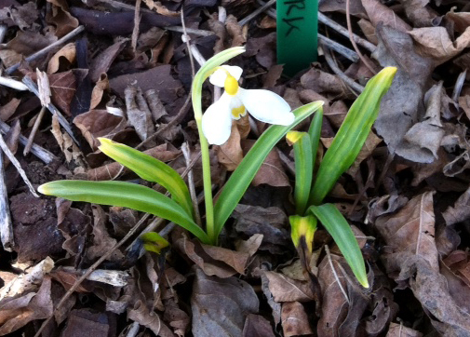
Yellows: Bill Clark
Galathophilia

Slide 42
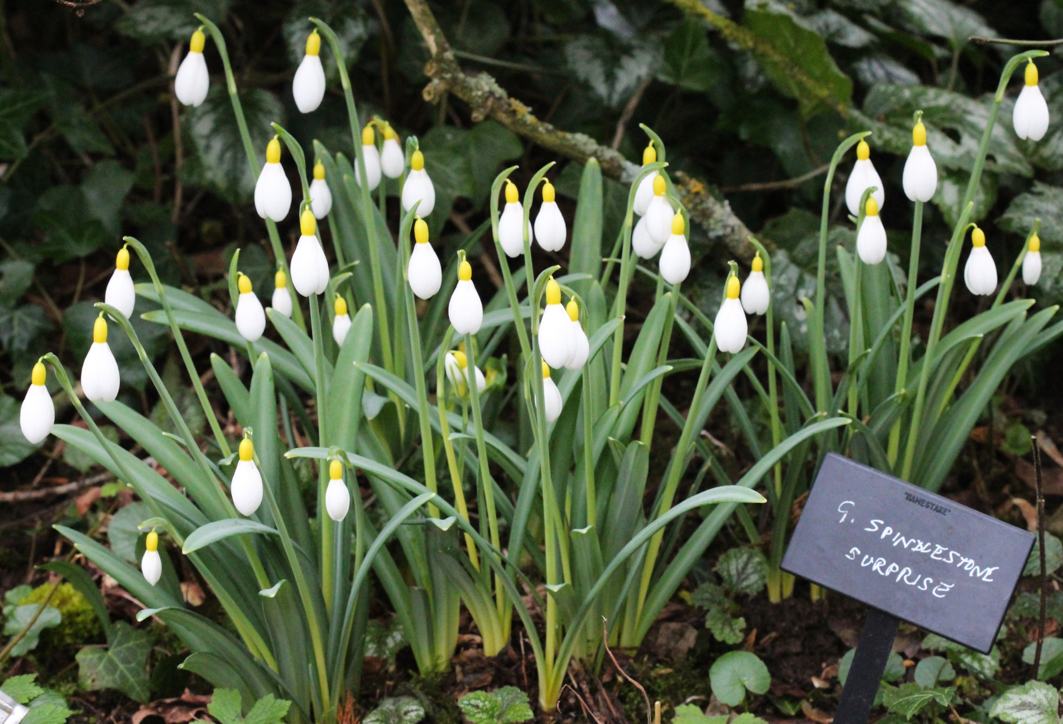
Yellows: Spindlestone Surprise
Galathophilia

Slide 43
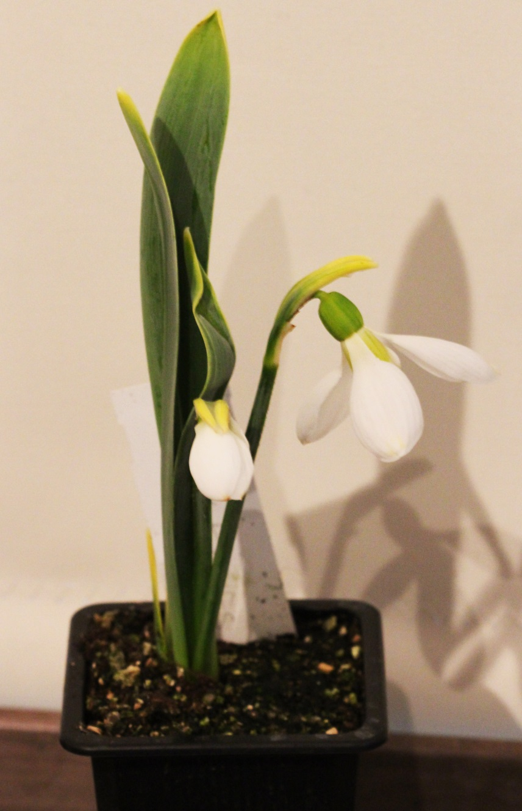
Yellows: Carolyn Elwes
Galathophilia

Slide 44
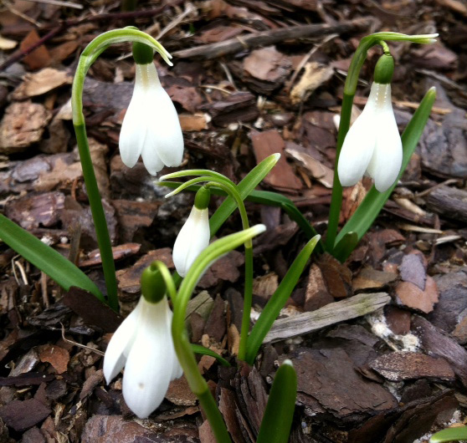
Poculiformis: Angelsey Abbey
Galathophilia

Slide 45
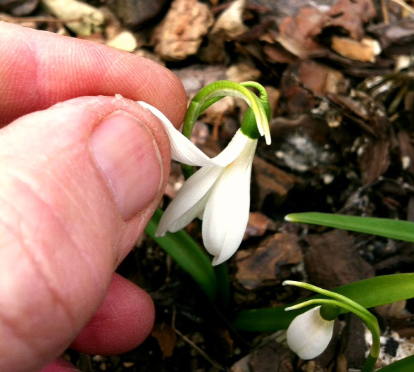
Poculiformis: Angelsey Abbey
Galathophilia

Slide 46
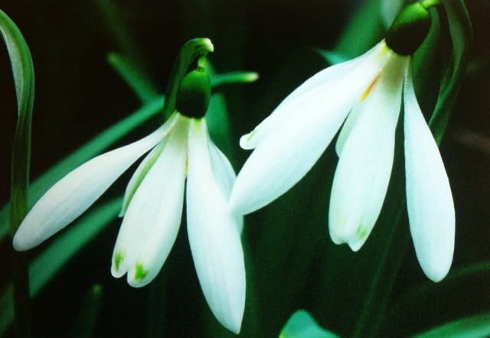
Poculiformis: Angelique
Galathophilia

Slide 47
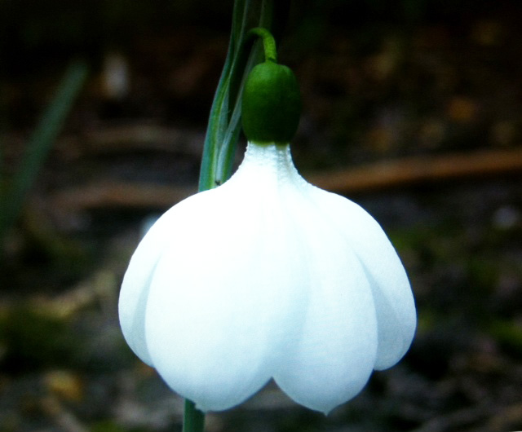
Poculiformis: E. A. Bowles
Galathophilia

Slide 48
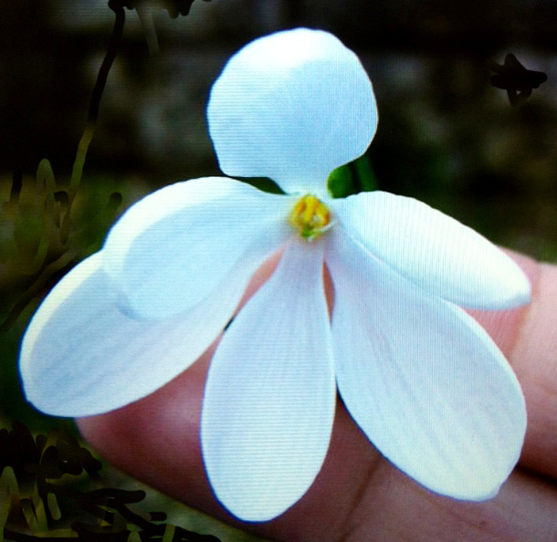
Poculiformis: E. A. Bowles
Galathophilia

Slide 49
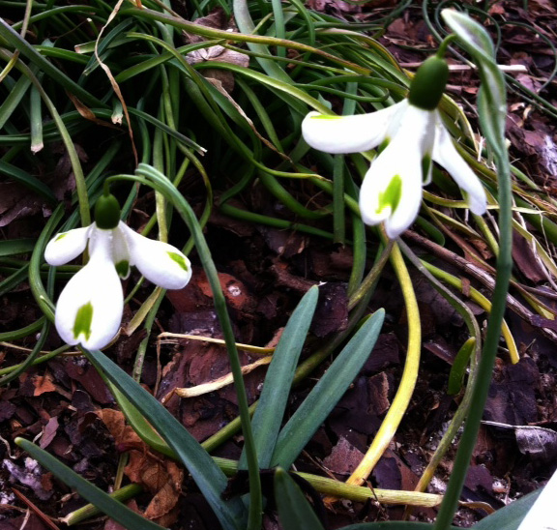
Inverse Pocs: Trumps
Galathophilia

Slide 50
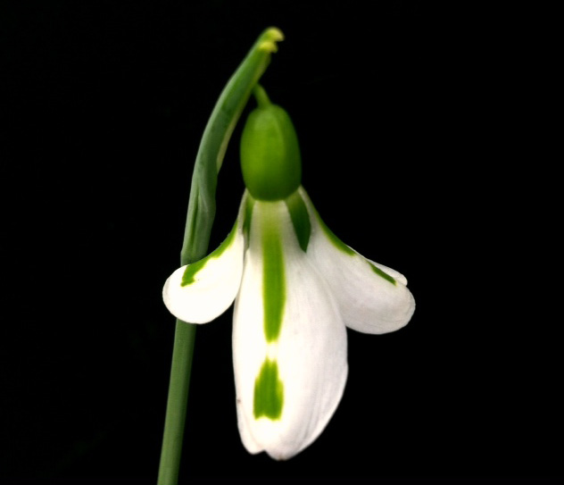
Inverse Pocs: South Hayes
Galathophilia

Slide 51
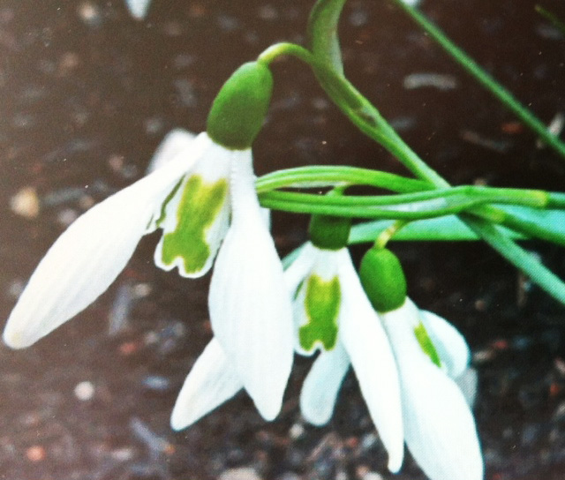
Unusual: Daphne’s Scissors
Galathophilia

Slide 52
Unusual: Modern Art
Galathophilia

Slide 53
Unusual: Narwal
Galathophilia

Slide 54
Unusual: Luke
Galathophilia

Slide 55
Unusual: Diggory
Galathophilia

Slide 56
Unusual: Lord Lieutenant
Galathophilia

Slide 57
Unusual: Green Tear
Galathophilia

Slide 58
Chipping
Galathophilia

Slide 59
Chipping
Galathophilia

Slide 60
Chipping
Galathophilia

Slide 61
Chipping
Galathophilia

Slide 62
Chipping
Galathophilia

Slide 63
Chipping
Galathophilia

Slide 64
Chipping
Galathophilia

Slide 65
Chipping
Galathophilia

Slide 66
Chipping
Galathophilia

Slide 67
Chipping
Galathophilia

Slide 68
Chipping
Galathophilia

Slide 69
Chipping
Galathophilia

Slide 70
Chipping
Galathophilia

Slide 71
Chipping
Galathophilia

Slide 72
Chipping
Galathophilia

Slide 73
Chipping
Galathophilia

Slide 74
Chipping
Galathophilia

Slide 75
Chipping
Galathophilia

Slide 76
Chipping
Galathophilia

Slide 77
Chipping
Galathophilia

Slide 78
Winter Protection
Galathophilia

Slide 79
Winter Protection
Galathophilia

Slide 80
Diminutives: Grumpy
Galathophilia

Slide 81
Diminutives: Tiny Tim
Galathophilia

Slide 82
Diminutives: Icicle
Galathophilia

Slide 83
Diminutives: Little Drip
Galathophilia

Slide 84
Diminutives: Elfin
Galathophilia

Slide 85
The Lonely Snowdrop
Galathophilia

